Slide 1

Introduction to Probability Theory
Introduction to Stochastic Modelling and Processes (SMP)
Gunvor Elisabeth Kirkelund
Lars Mandrup
Gunvor Elisabeth Kirkelund

Slide 2
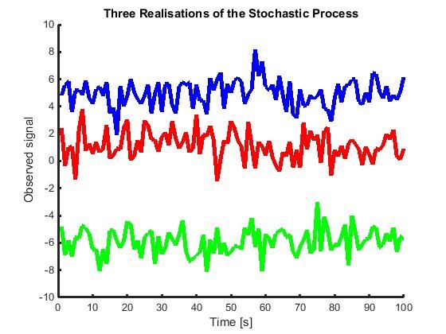
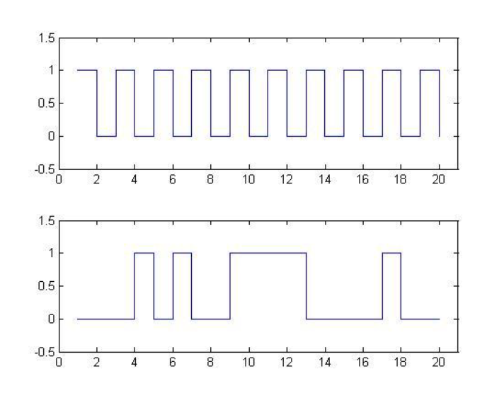
Why Stochastic Modelling and Processes?
All scientific and engineering work contain some element of randomness
How can I get anything out of this noisy signal?
How much can I conclude from my measurements?
How many tests / size of population do I have to do to validide my system/method/model?
Stochastic processes is a way to handle and modelling the randomness
Mandatory if you want to take a master degree

Slide 3




Content of the Course
Probability theory
Stochastic Processes
Statistics
Without time variable
Probabilistics
With time variable
Probability theory tells us what is in the sample given nature.
Statistics tells us about nature given the sample.
Given a regular dice probability theory can tell me how many times I will get a 6, when I roll the dice 100 times.
Data/
Sample
Nature/
Population
Rolling an unknown dice 100 times, I 12 times get a 6.
Statistics tell me the nature of the dice (is it regular or not).

Slide 4
Topics
Probability
Data/
Sample
Nature/
Population
Statistics
Probability Theory and Stochastic Processes
Basic probability theory
Probability distributions
Stochastic (random) processes
Statistics
Statistical tests
Model estimation
Linear regression

Slide 5
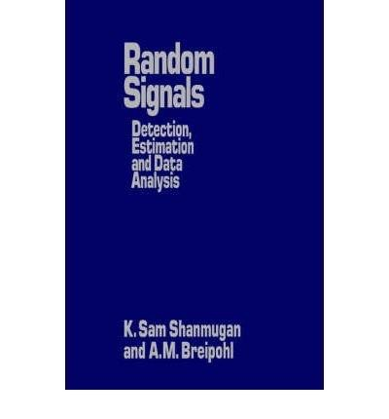
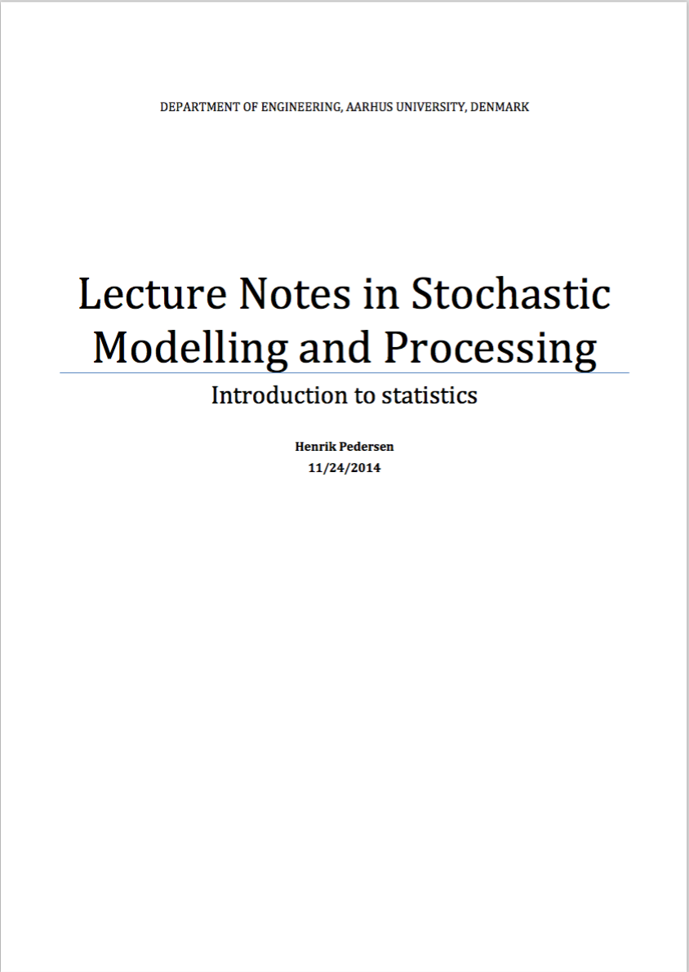
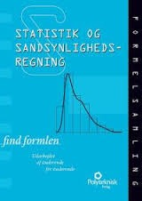
Curriculum
“Random Signals”, Shanmugan and Breipohl, chap. 2, 3 and 8
“Lecture Notes in Stochastic Modelling and Processing”, H. Pedersen (supplementary - statistics)
“Statistik og Sandsynlighedsregning - find formlen”

Slide 6
Course Format
One 4 hours lesson each week in 14 weeks
Exam
3 hours written exam
Teachers:
Lars Mandrup, room 306E, lma@ase.au.dk
Gunvor Elisabeth Kirkegaard, room 300E, gek@ase.au.dk

Slide 7
Lecture Format
The course will consist of 4 hour lessons each week.
In the first 2 hours we will give introductions to each topic
In the second 2 hours you will work in groups to solve different types of Group Assignment problems related to the curriculum.
As the time during these 4 hour sessions are very limited we expect you to have read the curriculum and solved the introductory assignments before the lecture. Solutions will be provided to all introductory assignments.

Slide 8
What we expect before you begin the course
You know how to integrate and differentiate
Know about convolution of two functions
Have a basic knowledge of Matlab
And have installed Matlab

